Slide 1
CS371 Project Evaluation
Reya Reyatijiang
ID: 12155902

Slide 2
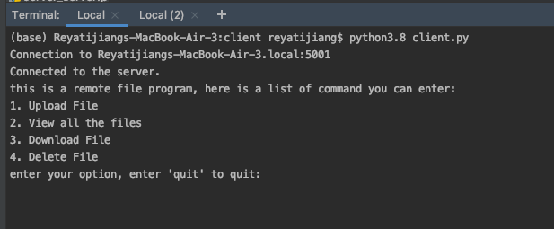
Client Side Demo:
1.Connecting to the server portal
2. Executing command through shell

Slide 3
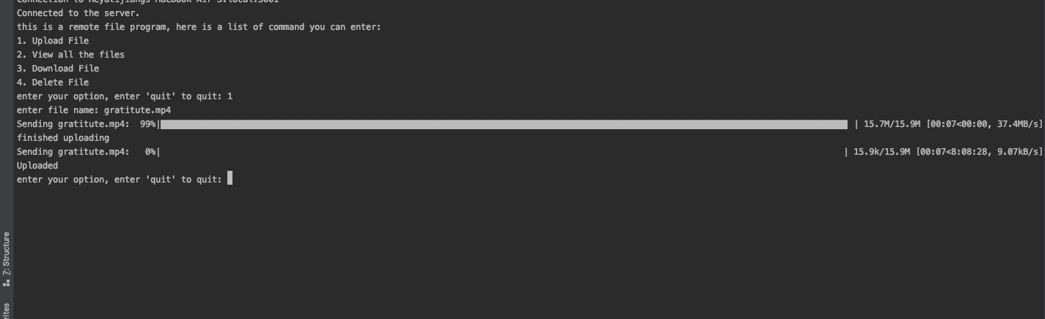
Uploading file

Slide 4
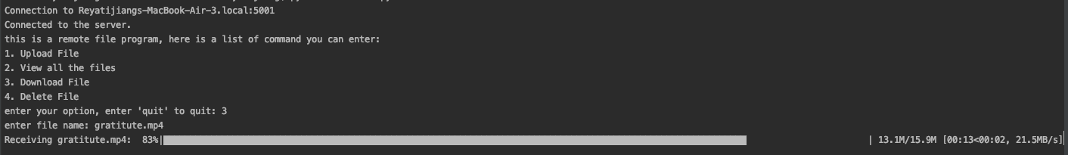
Downloading files

Slide 5
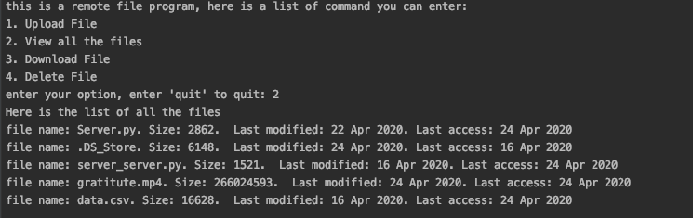
Looking at all the files at the Dir

Slide 6
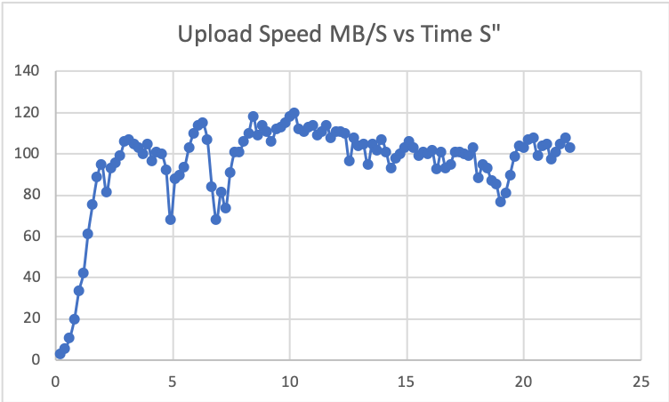
Network Performance Upload: (I don’t have enough space on my mac to support 1 min of download, sorry.)
This graph is largely what I expected,
My avg speed is about 100 MB/sec. And it start off very low and gradually increase and stayed around average.

Slide 7
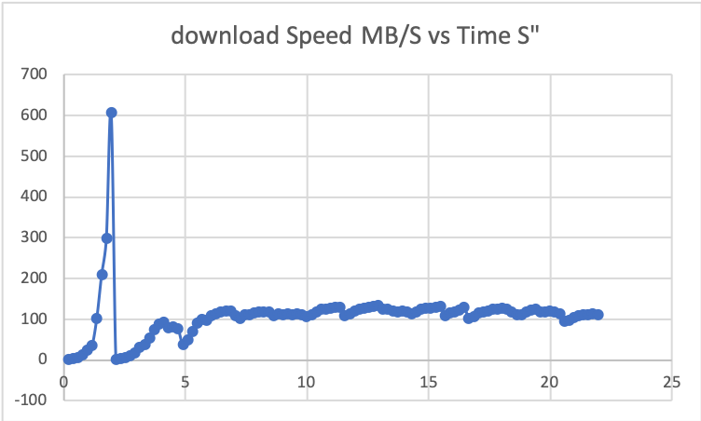
Download: (I don’t have enough space on my mac to support 1 min of download, sorry.)
The spike on the graph is not accidental,
every download has a spike occurs.

